Slide 1

Simplify ML Operation
FY 22 Hackthon

Slide 2
Customers often ask our guidance on operationalizing ML projects (or as simple as an ML model) as they bring their ML models to Azure ML.
While we have lots of reference architectural documentations and GitHub repos providing guidance on MLOps, the current assets tend to be very cumbersome and complex to guide our customers.
We have an opportunity to drive more impactful customer adoptions if we can improve our current approaches through simplified MLOps process, leveraging existing tools (i.e. ML Pipelines, Aure DevOps etc.).
We envision to address Role Clarity for everyone involved, clarity on the training, evaluation, deployment, inference and re-training process, and improvement on the continuous integration and delivery aspect in the MLOps process
Current MLOps assets are more involved
Notes:
Note: Don’t spend too much time on the “set-up” or problem statement. Viewers usually pick that up quickly, and they want to get to hearing about your project/solution.

Slide 3
MLOps Teams Involved
Infrastructure
Data Engineering
Data Science
Software Engineering
IT Operation
Implement infrastructure or data storage, & computation units.
Monitor and manage the overall infrastructure, enforcing policies and resolving service interruptions.
Implement pipelines for data transfer, and transformation. Also plays the Stuart role
Typically follow Agile and DevOps processes to manage model build, test, and deployment; and integration into applications. Help in operationalizing both Data & ML Pipelines
Explore and experiment with data, often using ad-hoc scripts and notebooks without a formal code management process.

Slide 4
Conceptual End to End MLOps
Raw Data
Data Ingestion Pipeline
Ingest
Process
Serv
Processed Data
AML Pipeline
Dataset
Train
Evaluate
Register
Model Registry
Deploy Model
Scoring Image
ACI
Repo
DevOps Pipeline (Model Training CI)
Code Quality Check
Unit Tests
Build AML Pipeline
Publish AML Pipeline
Run AML Pipeline
Run Model Deployment
DevOps Pipeline (Environment CI)
ML Workspace creation
Notes:
Note: Don’t spend too much time on the “set-up” or problem statement. Viewers usually pick that up quickly, and they want to get to hearing about your project/solution.

Slide 5
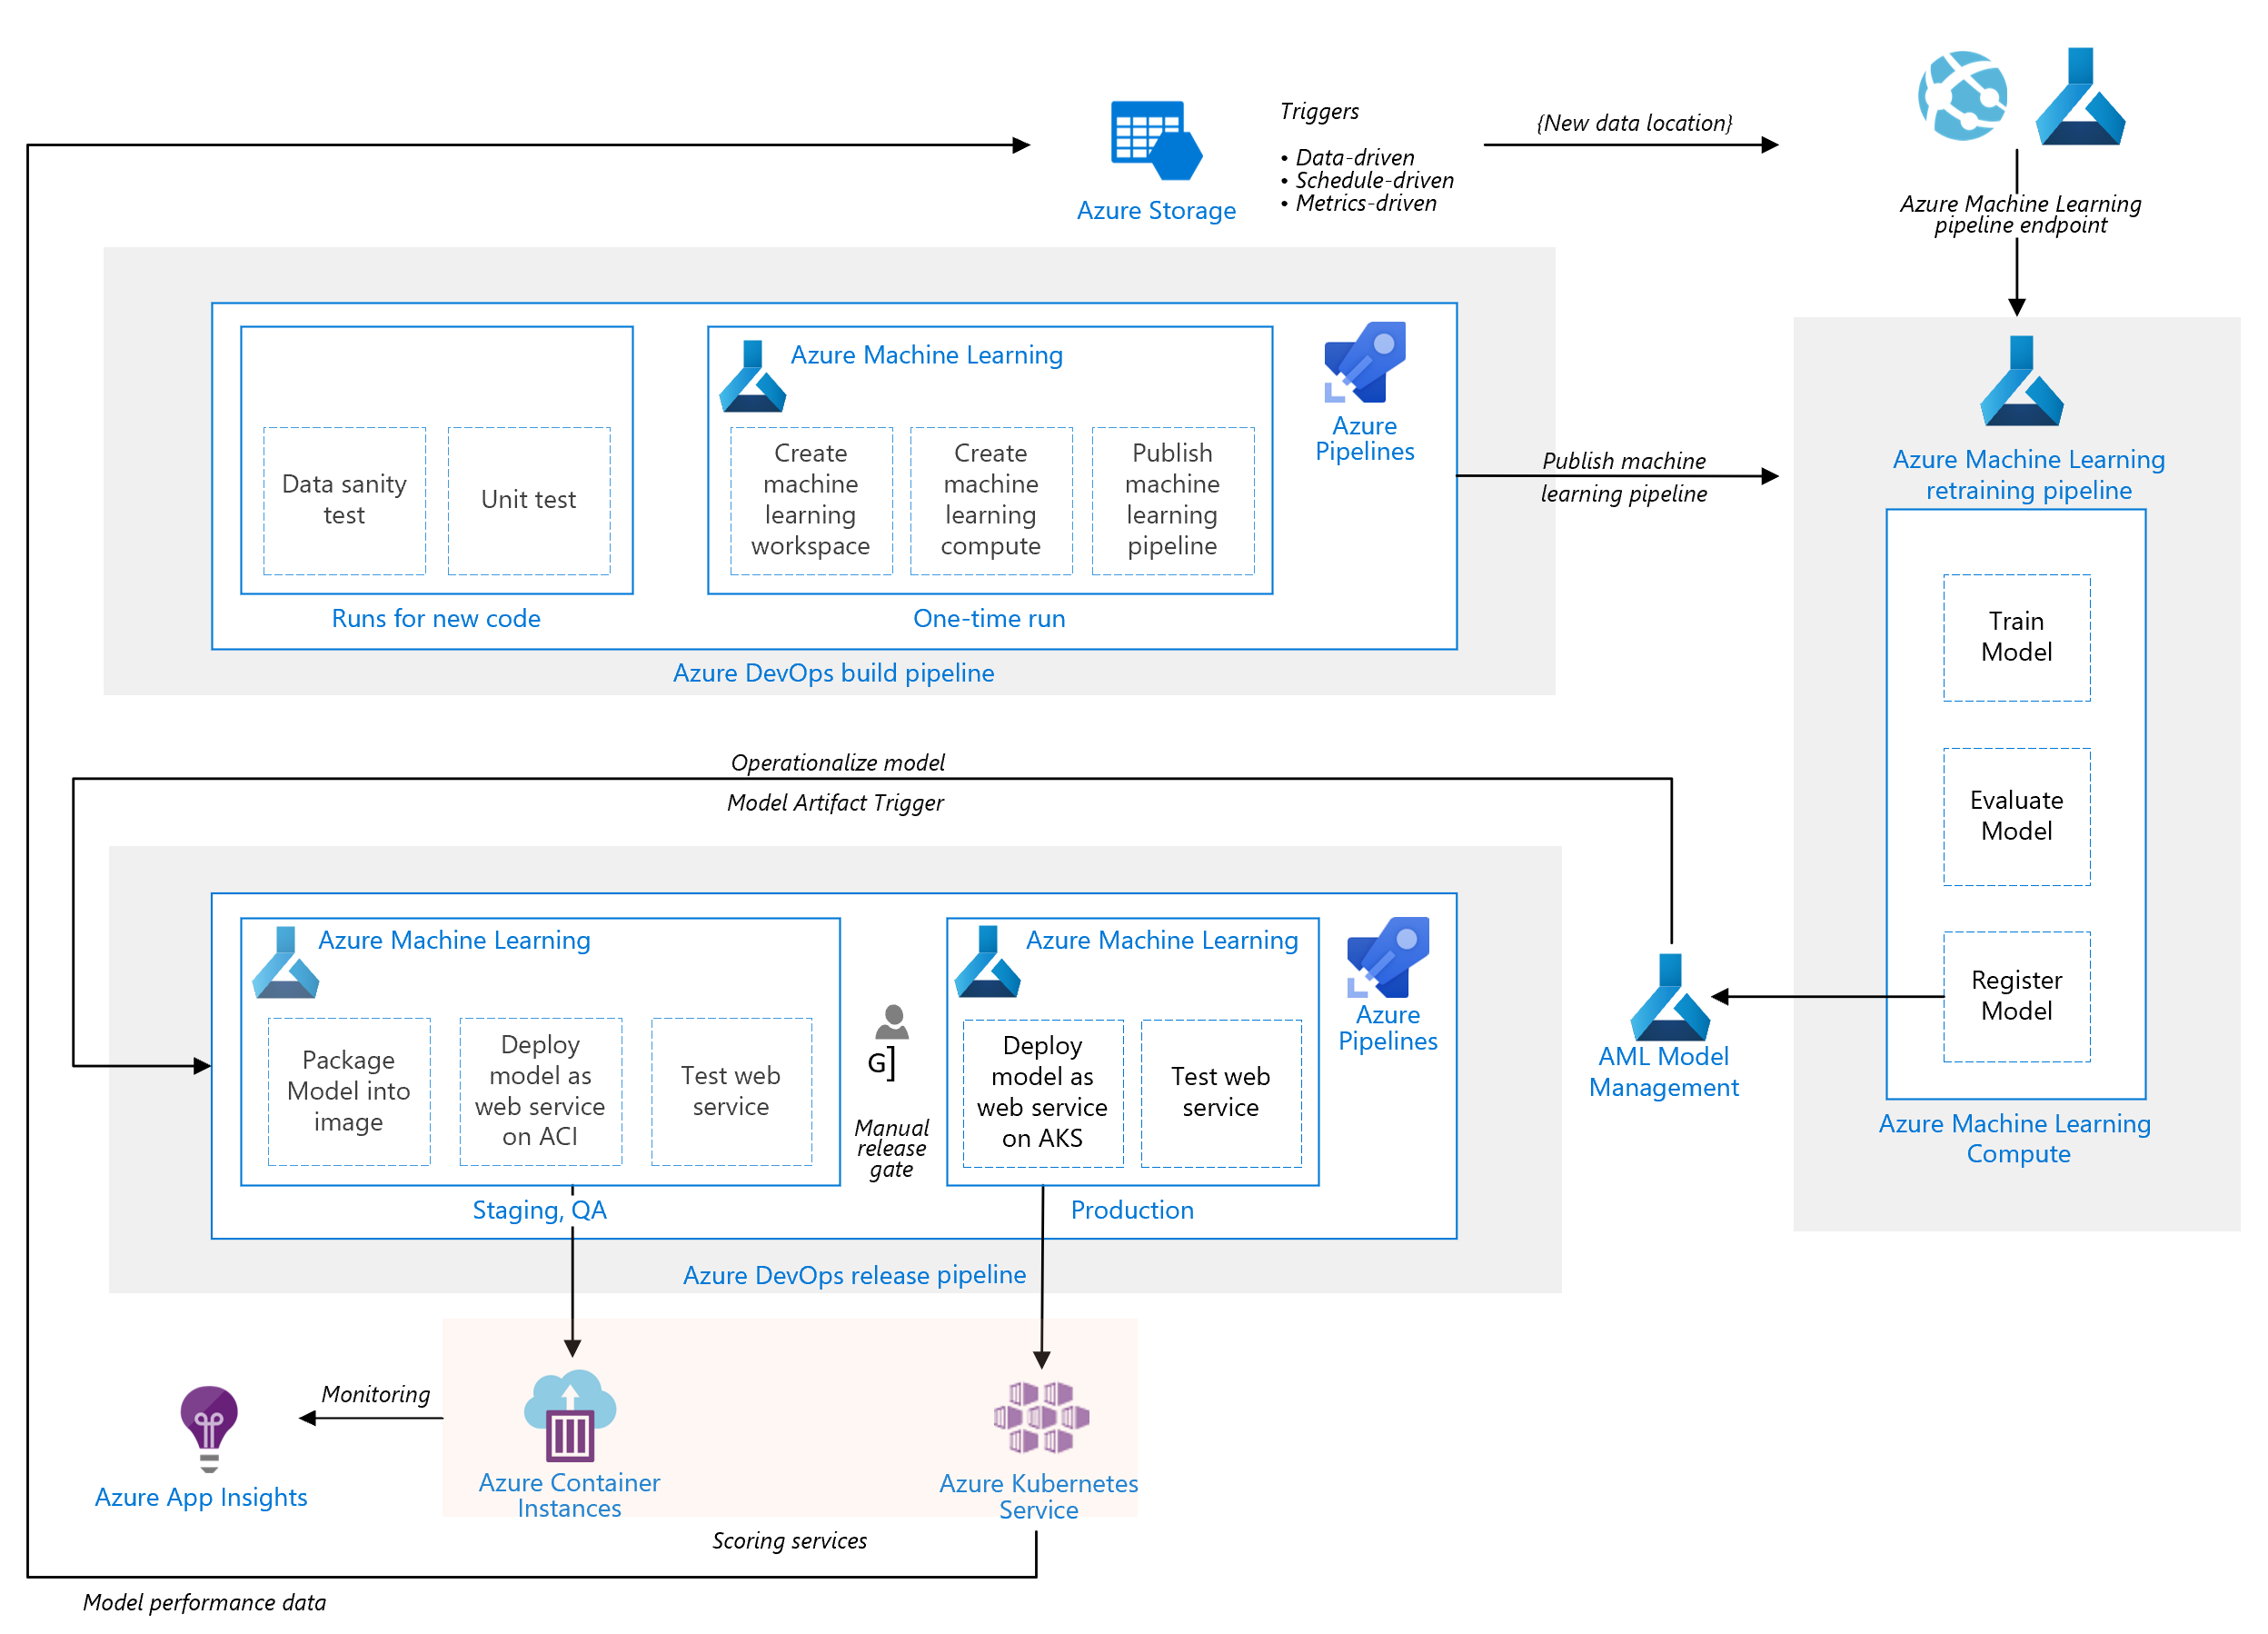

Slide 6
Implementation process
Local Model Build
Development Environment, Code Quality, Azure ML connect
Azure ML Pipeline Creation (Partial MLOps)
Azure (DevOps) + ML Pipelines– Automated Testing, CI, CD
Observability: Training Evaluation Metrics
Observability: Inference Metrics, Alerts, Dashboard
Ops for ML: Data Ingestion & Pre-processing
Ops for Data Ingestion, Pre-processing & ML: CI/CD Pipelines as Code (YAML)

Slide 7
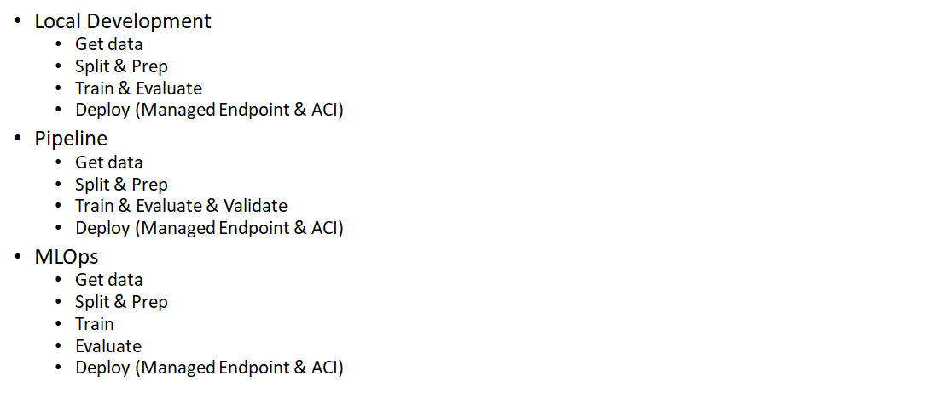
Basic Model Development

Slide 8
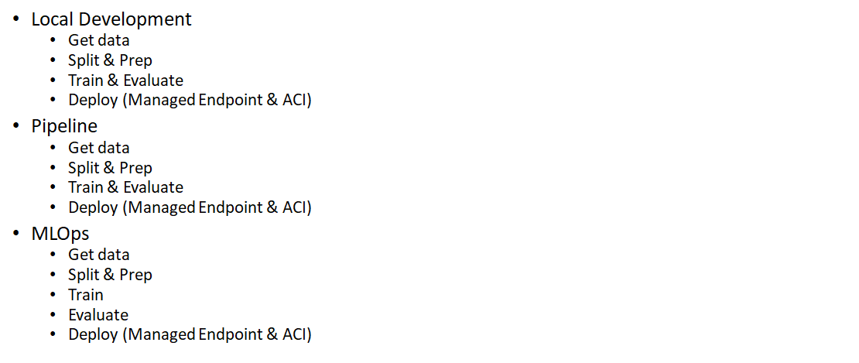
AutoML Model Developent

Slide 9
What’s your hack project story?
Where did the idea come from? (very briefly)
The importance of ML Ops is not fully recognized and democratized.
Why do you care about this idea/area?
ML Ops has become a key component for ML products. But it is not fully recognized, and still need to be further democratized. Our work try to fill those gaps.
How does this relate to your day jobs, if at all?
Notes:
Note: Don’t spend too much time on the “set-up” or problem statement. Viewers usually pick that up quickly, and they want to get to hearing about your project/solution.

Slide 10
Customers often ask our guidance on operationalizing ML projects (or as simple as an ML model) as they bring their ML models to Azure ML.
While we have lots of reference architectural documentations and GitHub repos providing guidance on MLOps, the current assets tend to be very cumbersome and complex to guide our customers.
We have an opportunity to drive more impactful customer adoptions if we can improve our current approaches through simplified MLOps process, leveraging existing tools (i.e. ML Pipelines, Aure DevOps etc.).
We use it every day and on various capacity. Any improvement to simplification always improves our productivity. It’s in our DNA
Current MLOps assets are more involved
Notes:
Note: Don’t spend too much time on the “set-up” or problem statement. Viewers usually pick that up quickly, and they want to get to hearing about your project/solution.

Slide 11
Value for the customer
Increase productivity
Ease of use
Scalability of ML/DL/RL Models
Increase efficiency
Onboard consistence ML model projects
Better Governance
Operational Excellence and monitoring
Various use case can be applied
Security compliance
Streamlined Automated CI/CD Process
Monetize AI to build new revenue model
Sustainability

Slide 12
Value for Microsoft
Increase consumption
Increase productivity
Improved Customer satisfaction
Simple repeatable asset
Art of possibility
Thought leadership
Gain market share – New customers
Improved Trust on Microsoft

Slide 13
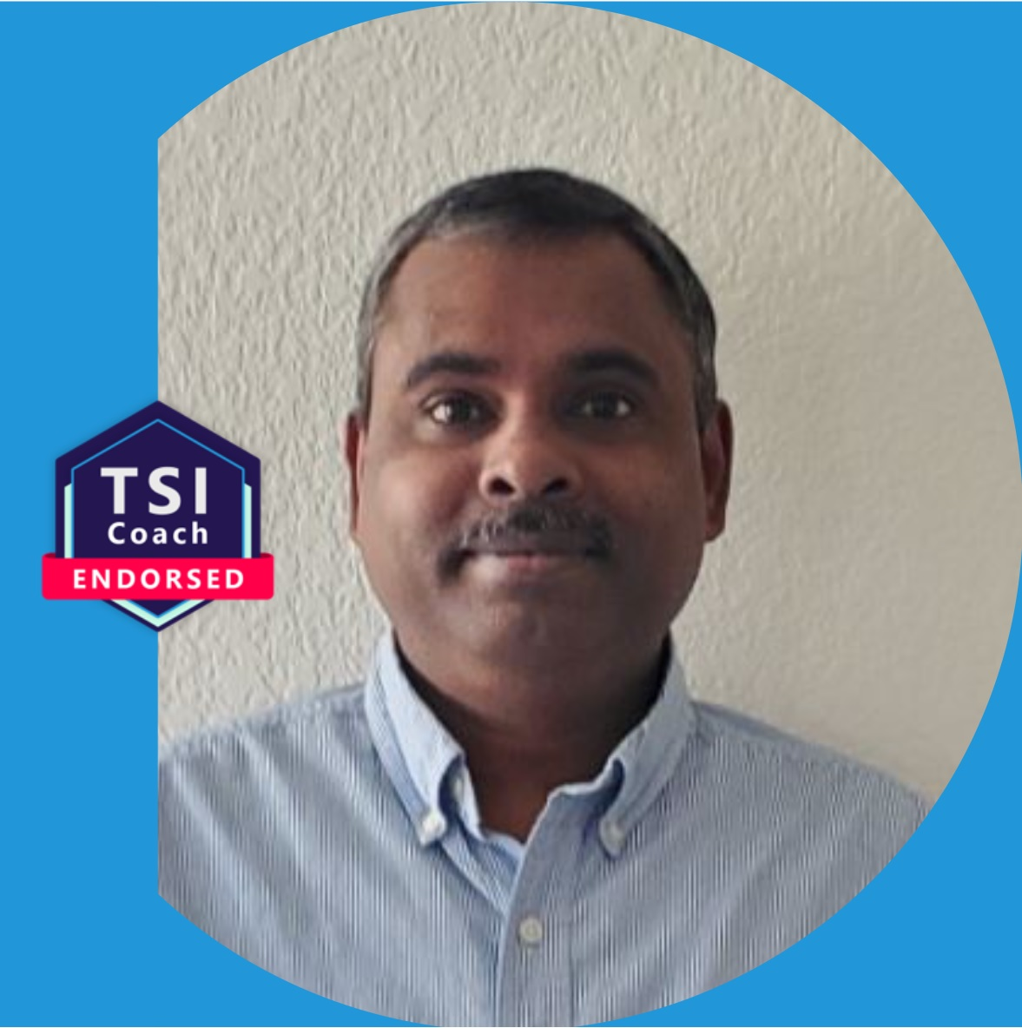






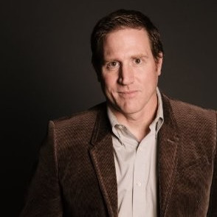

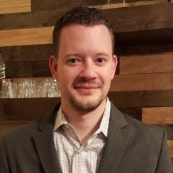
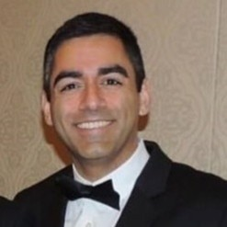


Midwest Dream Team
Balamurugan
Balakreshnan
Vandana Rana
Shruti Harish
Mark Hoiland
Megan Masanz
Meer Alam
Atanu Rudra
Robert Nottoli
Dong Ruan
Jonathan Scholtes
Sina Fakhraee
Imran Burki
Mickey Patel

